Slide 1
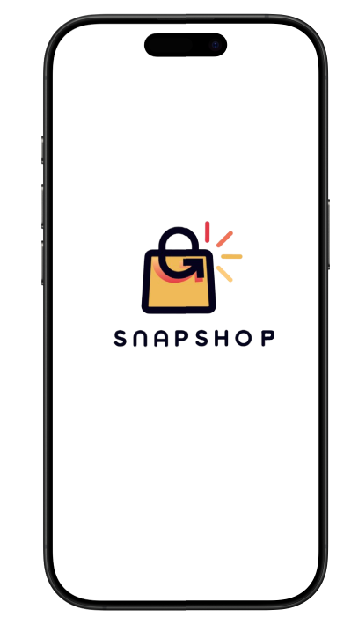
SnapShop: Revolutionizing Shopping with AI Visual Search
Omar Abbas, Tracy Mansour, Omar Jaber, Layana Kreidly, and Abbas Fares

Slide 2
Why SnapShop is Needed
1
Time-consuming Manual Search
2
Visual Recognition
3
Enhanced User Experience
Customers often recognize products visually but may not know the exact name, making text-based search ineffective.
Traditional shopping apps rely on manual text-based search, which can be time-consuming and frustrating for customers.
A visual search eliminates frustration and enhances the user experience, allowing for faster and easier product discovery.
4
Inclusive Shopping
AI-powered search enables a more inclusive shopping experience for those unfamiliar with product categories or names.

Slide 3
Key Features of SnapShop
Picture Search
Quick Add to Cart
Product Suggestions
Take a picture of any product to instantly find it in the shop.
Find and add products to your cart in seconds, no typing required.
Automatically see related items based on your visual search.

Slide 4

Why SnapShop is Good
Convenience
Speed
Simplifies the shopping experience by removing the need for text-based searches.
Faster search results via images, saving time for busy shoppers.
Accessibility
Innovation
Useful for users who may have difficulty typing or identifying product names.
Utilizes cutting-edge AI technology to provide a modern shopping experience.

Slide 5
Market Opportunity
1
Increasing Online Shopping
The reliance on online shopping has been steadily increasing since 2020.
2
Rise of Visual/Voice Search
The market has seen a rise in visual and voice-based search solutions in e-commerce.
3
Demand for Smarter Experiences
Consumers expect smarter, faster, and more intuitive shopping experiences.

Slide 6




User Experience
Step 1
Open the app and tap on the camera icon.
Step 2
Take a picture of the product you want to find.
Step 3
The app identifies the product and shows available options in the shop.
Step 4
Add the product to your cart or explore recommended items.

Slide 7
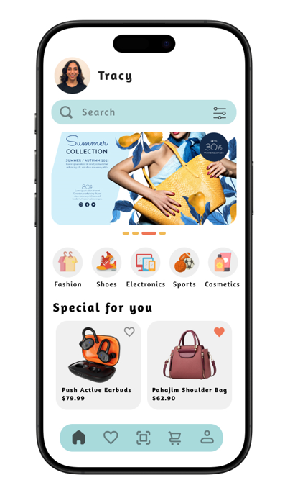
Home Screen
1
Easy Navigation
2
Featured Products
The home screen has a clear focus on the camera icon for image search.
Featured products and promotions are visible for quick browsing.
3
User Accounts
Access to user shopping lists and account settings is provided.

Slide 8
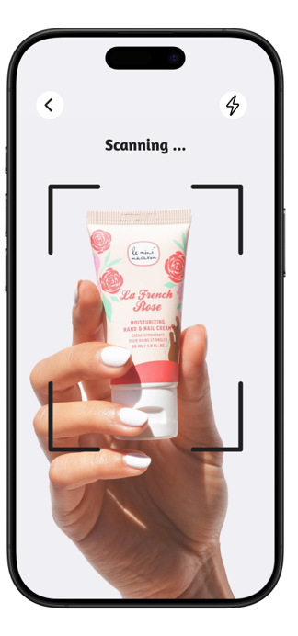


Visual Search
Take a Picture
Search Results
The UI guides users to take a picture of the product they want to find.
The search results display similar items with options to add them to the cart.

Slide 9
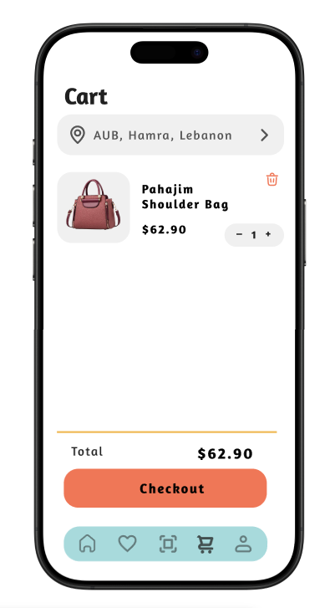
Shopping Cart
Clean Design
The shopping cart has a clean and simple design for reviewing selected products.
Easy Modification
Easy access to adjust quantities or remove items.
Cost Transparency
Clear display of total cost.

Slide 10
Figma Link

